Slide 1
Normalization of Database Tables

Slide 2
Database Tables and Normalization
Table is basic building block in database design
Table’s structure is of great interest
Two cases:
possible poor table structures in good database design
Normalization can help recognize a poor table and convert to good tables with good structure

Slide 3
Database Tables and Normalization
Normalization is process for re-assigning attributes to entities
Reduces data redundancies
Helps eliminate data anomalies
Produces controlled redundancies to link tables
Series steps called normal forms

Slide 4
Normalization and Database Design
Normalization should be part of the design process
Make sure the proposed entities meet the required normal form before the table structures are created
Used to redesign or modify the existing table structures.
E-R Diagram provides macro view

Slide 5
Data Normalization
Primarily a tool to validate and improve a logical design so that it satisfies certain constraints that avoid unnecessary duplication of data
The process of decomposing relations with anomalies to produce smaller, well-structured relations

Slide 6
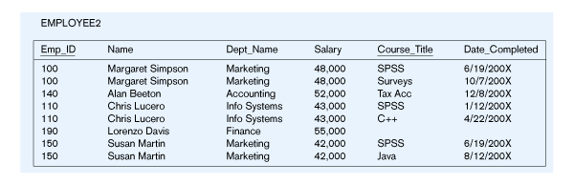
Example – Figure 5.2b
Question – Is this a relation?
Answer – Yes: unique rows and no multivalued attributes
Question – What’s the primary key?
Answer – Composite: Emp_ID, Course_Title

Slide 7
Well-Structured Relations
A relation that contains minimal data redundancy and allows users to insert, delete, and update rows without causing data inconsistencies
Goal is to avoid anomalies (next slide)
Insertion Anomaly – adding new rows forces user to create duplicate data
Deletion Anomaly – deleting rows may cause a loss of data that would be needed for other future rows
Modification Anomaly – changing data in a row forces changes to other rows because of duplication
General rule of thumb: a table should not pertain to more than one entity type

Slide 8
Anomalies in this Table
Insertion – can’t enter a new employee without having the employee take a class
Deletion – if we remove employee 140, we lose information about the existence of other classes
Modification – giving a salary increase to employee 100 forces us to update multiple records
Why do these anomalies exist?
Because we’ve combined two themes (entity types) into one relation. This results in duplication, and an unnecessary dependency between the entities

Slide 9
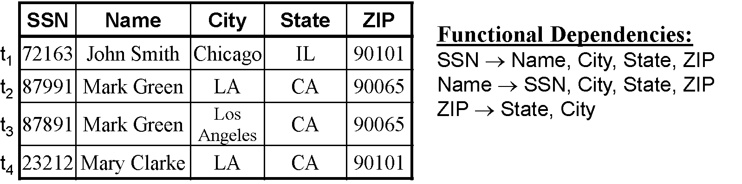
Functional Dependencies and Keys
Functional Dependency: The value of one attribute (the determinant) determines the value of another attribute

Slide 10
Normalization

Slide 11
First Normal Form
No multivalued attributes
Every attribute value is atomic
Derived Attributes should be removed
Fig. 5-2a is not in 1st Normal Form (multivalued attributes) ➔ it is not a relation
Fig. 5-2b is in 1st Normal form
All relations are in 1st Normal Form

Slide 12
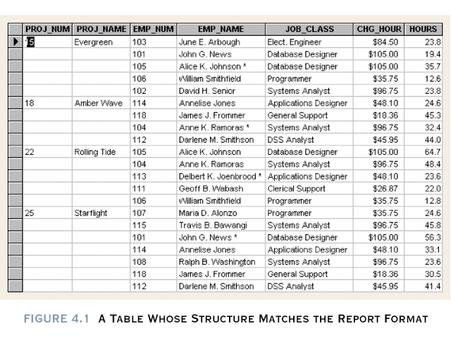
Table 4.1 should be here.

Slide 13
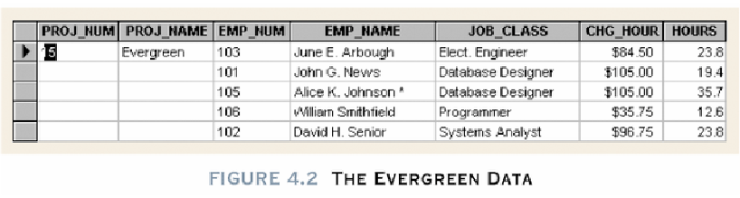
Figure 4.2 is insert here.
Repeating group (any project can have a group of data entries) which should not to be appeared in relational table

Slide 14
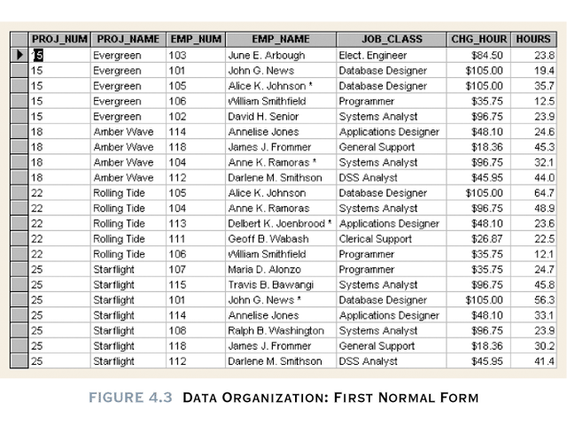
Data Organization: 1NF
PK
PK
Figure 4.3

Slide 15
Conversion to 1NF
Derived attributes must be removed
Repeating groups must be eliminated
Proper primary key developed
Uniquely identifies attribute values (rows)
Combination of PROJ_NUM and EMP_NUM

Slide 16
Conversion to 1NF
Repeating groups must be eliminated
Dependencies can be identified
A particular relationship between two attributes. For a given relation, attribute B is functionally dependent on attribute A if, for every valid value of A, that value of A uniquely determines the value of B.
A functional dependency exists when the value of one thing is fully determined by another. For example, given the relation EMP(empNo, empName, sal), attribute empName is functionally dependant on attribute empNo. If we know empNo, we also know the empName.

Slide 17
1NF Summarized
All key attributes defined
No repeating groups in table
All attributes dependent on
primary key

Slide 18
Second Normal Form
1NF plus every non-key attribute is fully functionally dependent on the ENTIRE primary key
Every non-key attribute must be defined by the entire key, not by only part of the key
No partial functional dependencies
Fig. 5-2b is NOT in 2nd Normal Form (see fig 5-23b)

Slide 19
Fig 5.23(b) – Functional Dependencies in EMPLOYEE2
Dependency on entire primary key
EmpID
CourseTitle
Name
DeptName
Salary
DateCompleted
Dependency on only part of the key
EmpID, CourseTitle ➔ DateCompleted
EmpID ➔ Name, DeptName, Salary
Therefore, NOT in 2nd Normal Form!!

Slide 20
Database Tables and Normalization
Normalization stages
1NF - First normal form
2NF - Second normal form
3NF - Third normal form
4NF - Fourth normal form
Business
Bioinformatics
Statistical data
Worse in performance (I/O)
Better in dependency

Slide 21
Desirable dependencies based on primary key Less desirable dependencies Partial based on part of composite primary key Transitive one nonprime attribute depends on another nonprime attribute

Slide 22
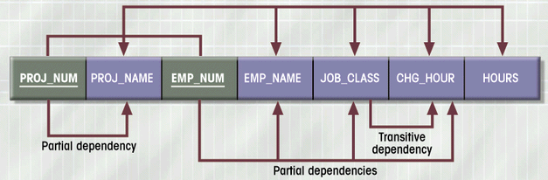
Dependency Diagram
Above: Desired Dependencies
Composite primary key
Figure 4.4
Below: Less Desired Dependencies

Slide 23
PROJ_NUM,EMP_NUM → PROJ_NAME, EMP_NAME, JOB_CLASS,CHG_HOUR, HOURS
DESIRED DEPENDENCIES
PROJ_NUM → PROJ_NAME
PARTIAL DEPENDENCIES
EMP_NUM → EMP_NAME, JOB_CLASS, CHG_HOUR
JOB_CLASS -> CHG_HOUR
TRANSITIVE DEPENDENCIES

Slide 24
Conversion to 2NF
Start with 1NF format:
Write each key component on separate line
Write original key on last line
Each component is new table
Write dependent attributes after each key
PROJECT (PROJ_NUM, PROJ_NAME)
EMPLOYEE (EMP_NUM, EMP_NAME, JOB_CLASS, CHG_HOUR)
ASSIGN (PROJ_NUM, EMP_NUM, HOURS)

Slide 25
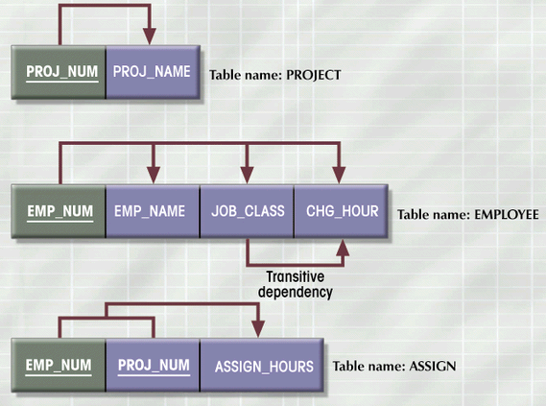
2NF Conversion Results
Figure 4.5

Slide 26
2NF Summarized
In 1NF
Includes no partial dependencies
No attribute dependent on a portion of primary key
Still possible to exhibit transitive dependency
Attributes may be functionally dependent on nonkey attributes

Slide 27
Conversion to 3NF
Create separate table(s) to eliminate transitive functional dependencies
PROJECT (PROJ_NUM, PROJ_NAME)
ASSIGN (PROJ_NUM, EMP_NUM, HOURS)
EMPLOYEE (EMP_NUM, EMP_NAME, JOB_CLASS)
JOB (JOB_CLASS, CHG_HOUR)

Slide 28
3NF Summarized
In 2NF
Contains no transitive dependencies

Slide 29
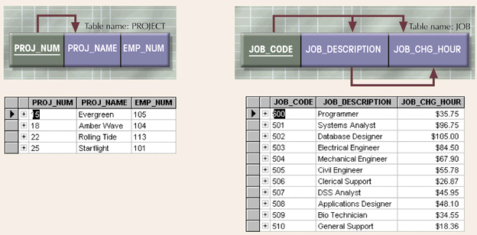
Additional DB Enhancements
Figure 4.6

Slide 30
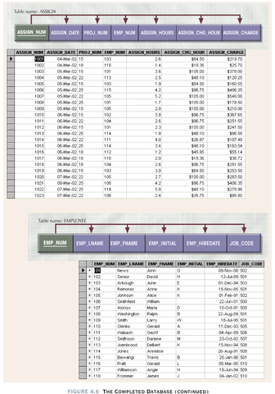

Slide 31
Boyce-Codd Normal Form (BCNF)
Every determinant in the table is a candidate key
Determinant is attribute whose value determines other values in row
3NF table with one candidate key is already in BCNF

Slide 32
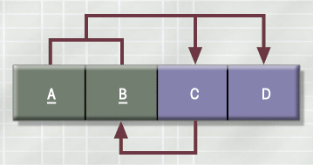
3NF Table Not in BCNF
Figure 4.7

Slide 33
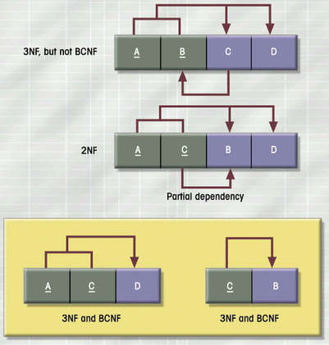
Decomposition of Table Structure to Meet BCNF
Figure 4.8

Slide 34
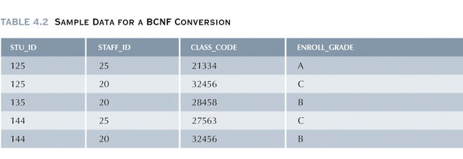
Example: BCNF conversion

Slide 35
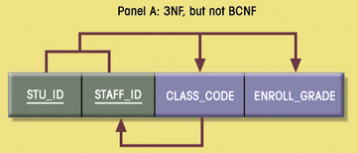
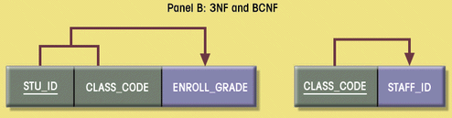
Decomposition into BCNF
Figure 4.9

Slide 36
Normalization and Database Design
Normalization should be part of the design process
Make sure the proposed entities meet the required normal form before the table structures are created
Used to redesign or modify the existing table structures.
E-R Diagram provides macro view

Slide 37
Normalization and Database Design
Normalization provides micro view of entities
Focuses on characteristics of specific entities
May yield additional entities
Difficult to separate normalization from E-R diagramming
Business rules must be determined

Slide 38
Normalization and Database Design
Contracting company’s example:
PROJECT (PROJ_NUM, PROJ_NAME)
EMPLOYEE(EMP_NUM, EMP_LNAME,EMP_FNAME,EMP_INITAL,
JOB_DESCRIPTION, JOB_CHG_HOUR);

Slide 39
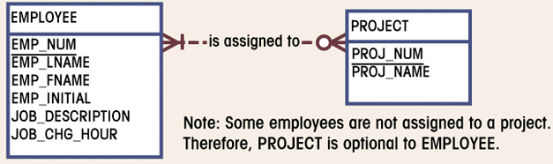
Initial ERD for Contracting Company
Figure 4.10
There is a transitive dependency
Already 3NF

Slide 40
Removal
PROJECT (PROJ_NUM, PROJ_NAME)
EMPLOYEE(EMP_NUM, EMP_LNAME,EMP_FNAME,EMP_INITAL,
JOB_CODE)
JOB (JOB_CODE, JOB_DESCRIPTION, JOB_CHG_HOUR);

Slide 41
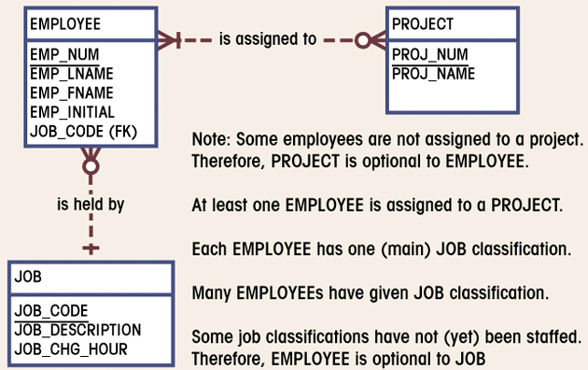
Modified ERD for Contracting Company
Figure 4.11

Slide 42
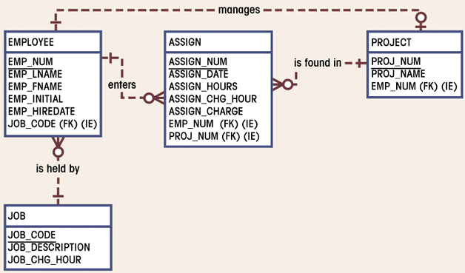
Final ERD for Contracting Company
Figure 4.12
(M:N) converting to (1:M)

Slide 43
PROJECT (PROJ_NUM, PROJ_NAME, EMP_NUM)
EMPLOYEE(EMP_NUM, EMP_LNAME,EMP_FNAME,EMP_INITAL,
EMP_HIREDATE, JOB_CODE)
JOB (JOB_CODE,, JOB_DESCRIPTION, JOB_CHG_HOUR);
ASSIGN((ASSIGN_NUM, ASSIGN_DATE, ASSIGN_HOURS,
ASSIGN_CHG_HOURS, ASSIGN_CHARGE, EMP_NUM, PROJ_JUM)

Slide 44
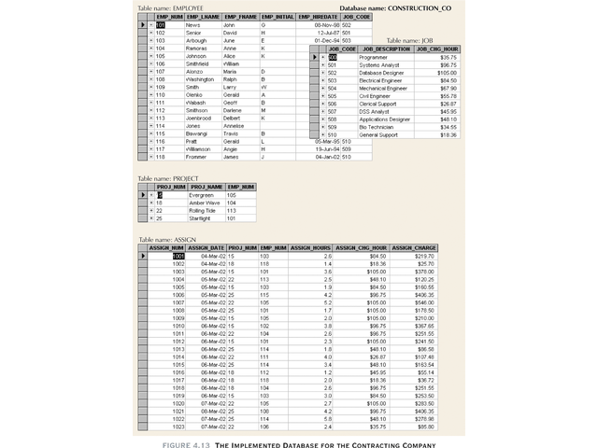

Slide 45
Denormalization
Normalization is one of many database design goals
Normalized table requirements
Additional processing
Loss of system speed

Slide 46
Denormalization
Normalization purity is difficult to sustain due to conflict in:
Design efficiency
Information requirements
Processing

Slide 47


Slide 48
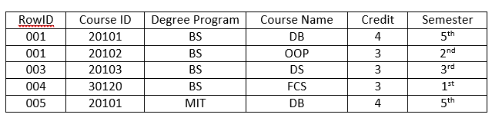

Slide 49
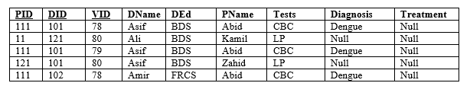

Slide 50
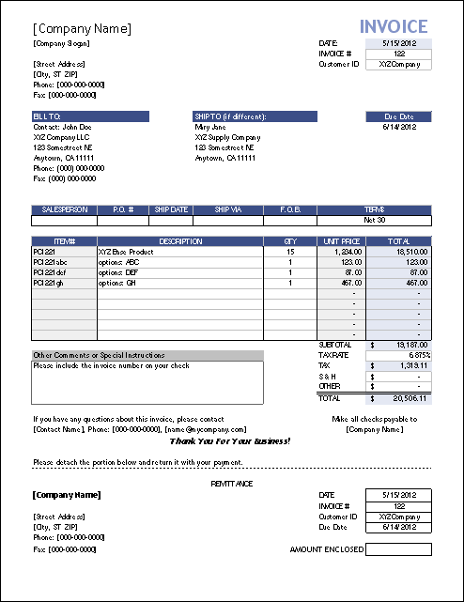

Slide 51
